Slide 1
Weekly update 8
Team Dragonflies

Slide 2
More data processing ...
Handle NA values:
Create binary columns as “indicators”
Rationale
Use median values to replace NA values
Notes:
Rationale: although many NA values exists => some of the columns are what we think as important for our prediction; it would lose certain amount of predictive effect if we simply leave them out.

Slide 3
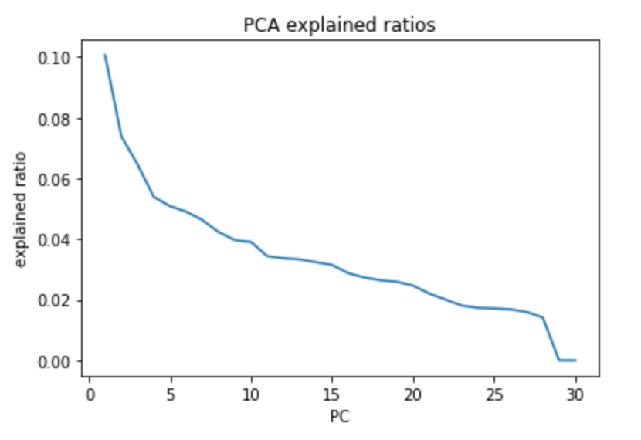
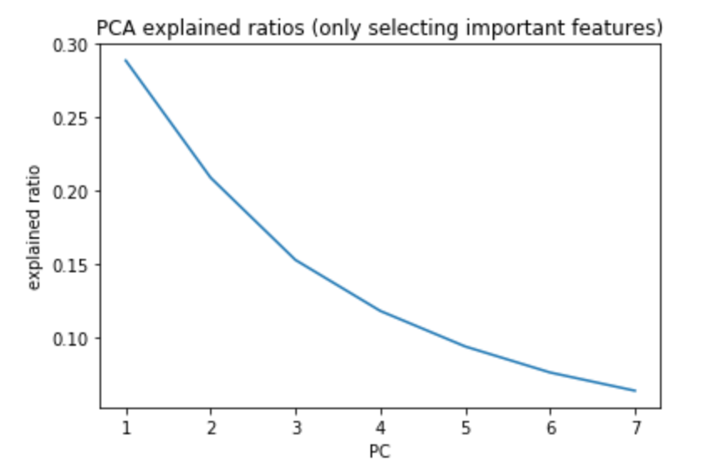
Numeric feature PCA
Notes:
Picture on the left is the explained ratios of each PC after conducting PCA on all numeric features in the dataset.
=> some observations: the first PC has about 0.10 explained ratio; the curve is not that smooth;
Picture on the right: we only select important numeric features,
=> some observations: the first PC has about 0.3 explained ratio over the whole dataset; the curve becomes much smoother

Slide 4
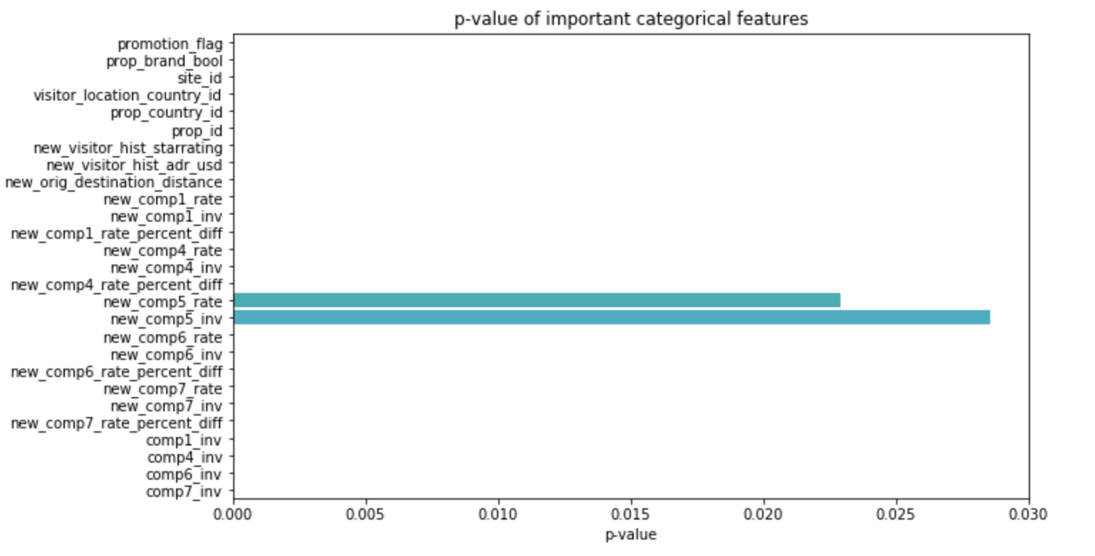
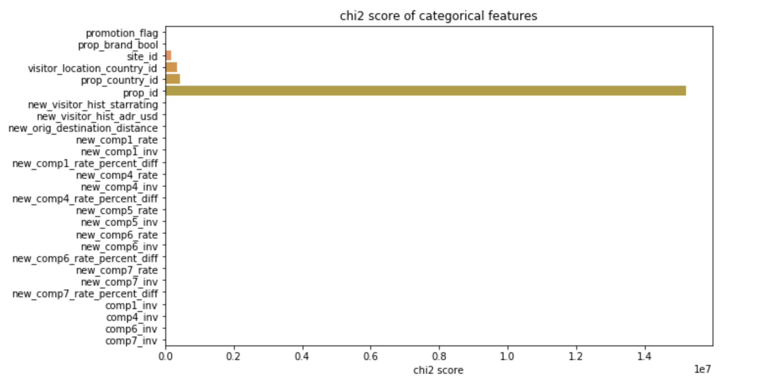
Chi2 ranking of Categorical variables
Notes:
“property_id” may not that important based on Chi-2 score;
But still, many categorical variables are shown as important from the plotting.

Slide 5
Linear Regression
Only feed into important numeric features:
training RMSE: 4809.81
test RMSE: 2720.88
Only feed into important categorical features:
training RMSE: 4802.44
test RMSE: 2738.13
Notes:
Strangely, regression using categorical variables alone can reach smaller RMSE than only feeding into numeric variables.

Slide 6
Literature review
“Combining Different Methods to Create Advanced Time Series Prediction”
https://www.kdnuggets.com/2016/11/combining-different-methods-create-advanced-time-series-prediction.html

Slide 7
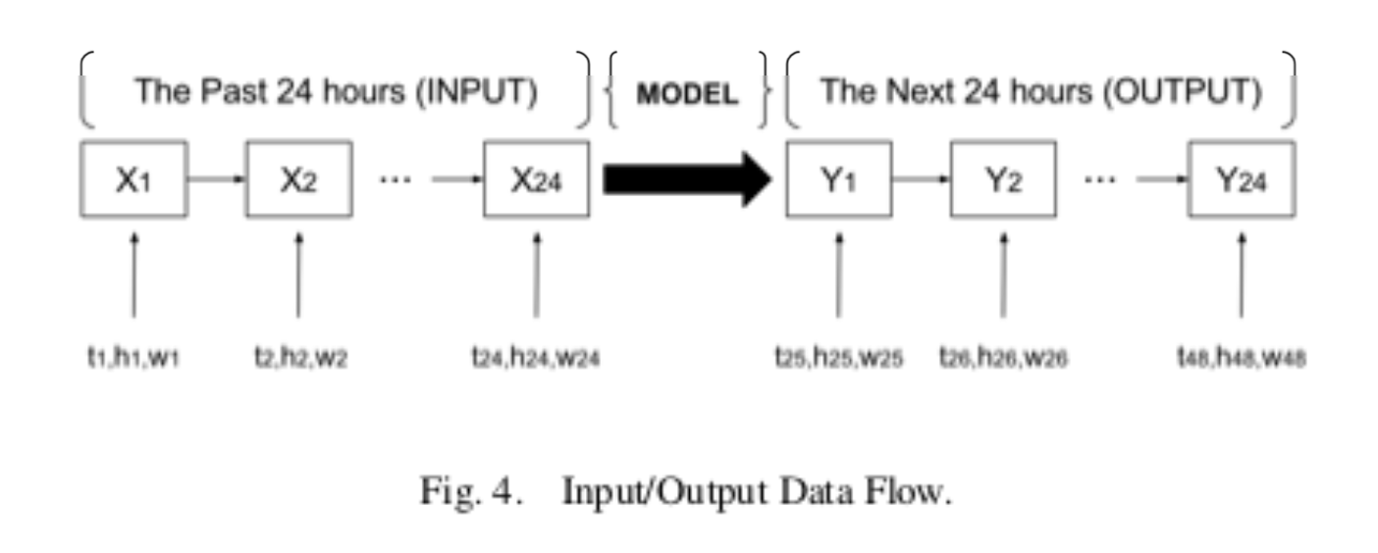
On Progress…
Use LSTM for price prediction:
Rationale
Input: hotel prices of the past week
Output: hotel prices of the next week (7 days)
*data pre-processing: order dataset by datetime, and split into weeks (days?)
Reference:
Sequence to Sequence Weather Forecasting with Long Short-Term Memory Recurrent Neural Networks.Akram Mohamed, El Chaker.International Journal of Computer Applications.2016
Notes:
Rationale: recent prices will have greater effect on current prices
Idea: just a raw conception => may also be split into days if that makes more sense

Slide 8
